Slide 1
Analysis of standard elliptic curves for the implementation of ECC in resource-constrained environments
Jaidev Chaudhary [189301036]
Saransh Sharma [189301164]

Slide 2
WHAT IS SYMMETRIC & ASYMMETRIC KEY CRYPTOGRAPHY ?
In Symmetric-key encryption, the message is encrypted using a key and decrypted with the same key, making it simple to use but less secure. It also needs a secure way of moving the key from one party to another.
Asymmetric Key Encryption is for both for public and private key encryption strategy. It uses separate keys to encrypt and decrypt a message or document. It is more reliable than the symmetric key encryption method, but it is relatively slower.

Slide 3
What is Private Key and Public Key ?
In Private key, the same key (secret key) is used for encryption and decryption. In this case, the key is symmetric because the only key is copied or shared by another party to decrypt the cipher text. It is faster than public key cryptography.
In Public key, two keys are used, one key is used for encryption and another key is used for decryption. One key (public key) is used to encrypt the plain text to convert it into cipher text and another key (private key) is used by receiver to decrypt the cipher text to read the message.

Slide 4
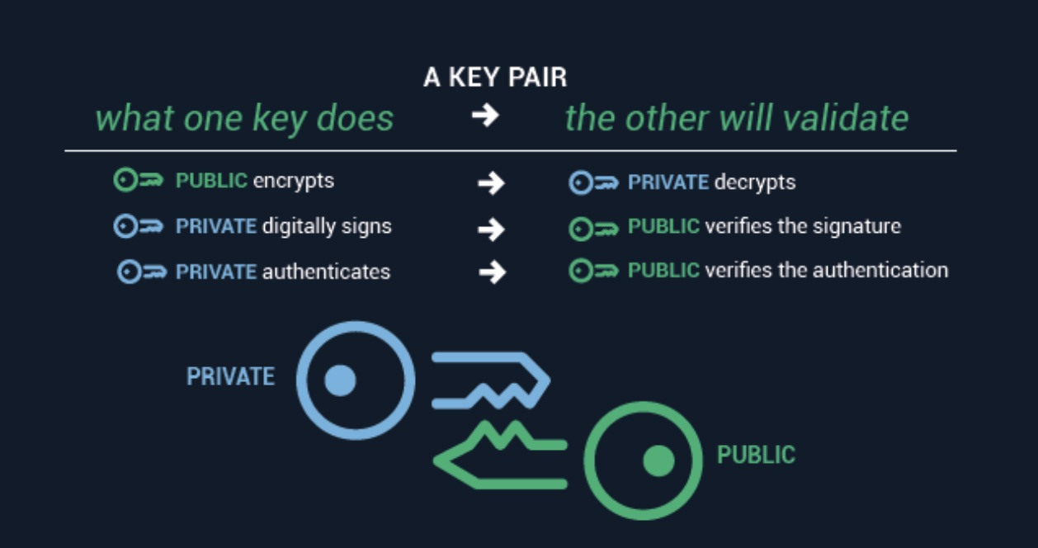

Slide 5
RSA Algorithm
RSA is an asymmetric cryptographic algorithm & as previously explained, the Public Key is given to everyone and Private key is kept private.
Some examples of asymmetric cryptography :
A client (e.g. browser) sends its public key to the server and requests for some data.
The server encrypts the data using client’s public key and sends the encrypted data.
Client receives this data and decrypts it.
DISADVANTAGE : Very slow in cases where large data is involved
Notes:
Do we add related MATH ??
1 min

Slide 6
Elliptic - Curve Cryptography
What you need for a public key cryptographic system to work is a set of algorithms that is easy to process in one direction, but difficult to undo.
In the case of RSA, the easy algorithm multiplies two prime numbers. If multiplication is the easy algorithm, its difficult pair algorithm is factoring the product of the multiplication into its two component primes.
Algorithms that have this characteristic — easy in one direction, hard the other — are known as Trap door Functions.
Finding a good Trapdoor Function is critical to making a secure public key cryptographic system.
But RSA is not the ideal system for the future of cryptography. In an ideal Trapdoor Function, the easy way and the hard way get harder at the same rate with respect to the size of the numbers in question. We need a public key system based on a better Trapdoor.
Notes:
ECC
Why is it better than RSA ?
1 min

Slide 7
In 1985, cryptographic algorithms were proposed based on elliptic curves.
An elliptic curve is the set of points that satisfy a specific mathematical equation.
The equation for an elliptic curve looks something like this:
y² = x³ + ax + b
Notes:
ECC Theory
1 min

Slide 8
For this, we restrict ourselves to numbers in a fixed range, like in RSA.
Rather than allow any value for the points on the curve, we restrict ourselves to whole numbers in a fixed range.
When computing the formula for the elliptic curve (y² = x³ + ax + b), we use the same trick of rolling over numbers when we hit the maximum (i.e. use the mod function)
If we pick the maximum to be a prime number, the elliptic curve is called a prime curve and has excellent cryptographic properties.
Notes:
Our research paper info (3-4 slides)
And what we are going to do
We are going to implement the different curves, analyse them using python
4-5 min

Slide 9
Security of ECC : Main Advantage
ECC-Based Scheme (Size of n in bits) | RSA (Modulus size in bits)
112 | 512
160 | 1024
224 | 2048
256 | 3072
384 | 7680
512 | 15360

Slide 10
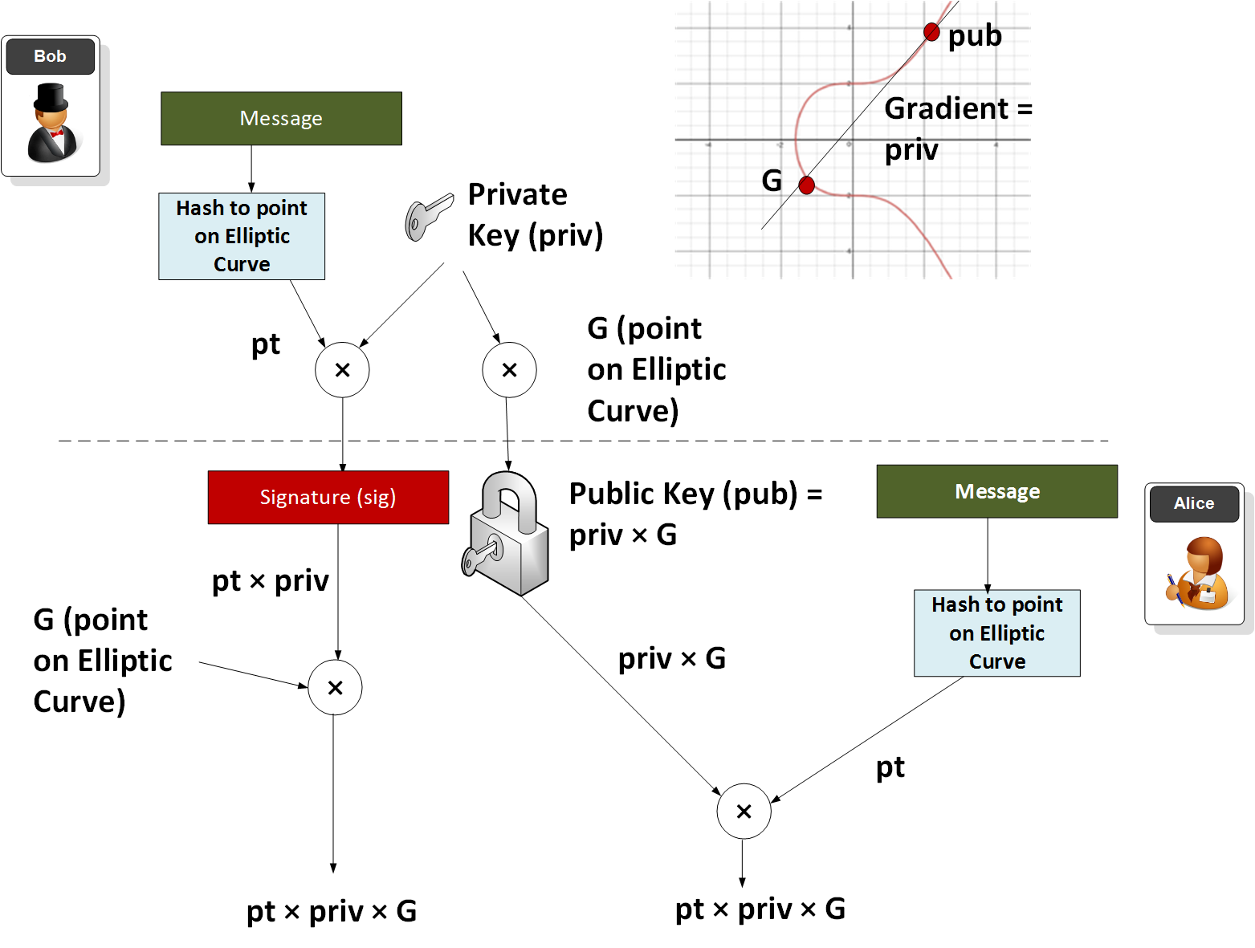
OVERVIEW of ENCRYPTION-DECRYPTION using ECC

Slide 11
What is our GOAL ?
There are multiple standard Elliptical Curves that can be used with the ECC scheme
Each standard of curve strives to maintain the difficulty of the Elliptic Curve Discrete Logarithm Problem (ECDLP)
The main idea is to select a curve which is safe against the known attacks on ECDLP
The analysis will be performed by considering each curve for the implementation of the Elliptic Curve Diffie-Hellman (ECDH) algorithm and the Elliptic Curve Digital Signature Algorithm (ECDSA).
The analysis is carried out using SageMath, which is a free open-source mathematics software system licensed under the GPL, using Python 3.
Notes:
START WITH RESEARCH PAPER SPECIFICALLY

Slide 12
What we have completed
Understood the mathematical foundations reqd.
Understood the algorithmic concepts reqd.
Created a web-app that plots the curves that are pre-defined
Basic interface ready
Back-end majorly completed
Currently gives O/P for predefined parameters
The entire code has been uploaded on GitHub:
https://github.com/Jaidev810/ECC-Cipher.git

Slide 13
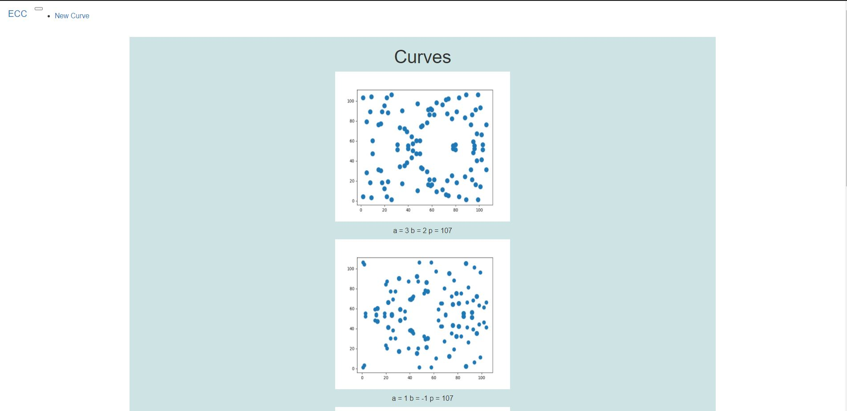
Output:
Home Page -->

Slide 14
What we plan to do Next
Selection of 5 best points from all the points on the curve.
Calculation of average time taken by a point
Calculation of average deviation
Learn SageMath (used for analysis of curves)
Improve UI of our web-app
Fixing Backend Bugs
Giving option for user input of Parameters for curves

Slide 15
Conclusion
Elliptic curve cryptosystems offer the highest strength-per-key-bit of any known public key system. With a 160 bits modulus, an elliptic curve system offers the same level of cryptographic security as RSA with 1024-bits modulus. The smaller key sizes result in smaller system parameters, smaller public key certificates, bandwidth savings, faster implementations, lower power requirements and small hardware processors.

Slide 16
References
Cryptography and Network Security, 4th Edition, William Stallings
https://www.researchgate.net/publication/322348730_Analysis_of_standard_elliptic_curves_for_the_implementation_of_elliptic_curve_cryptography_in_resource-constrained_E-commerce_applications
Flask Documentation: https://flask.palletsprojects.com/en/1.1.x/
Matplotlib library: https://matplotlib.org/stable/contents.html
Sqlalchemy: https://docs.sqlalchemy.org/en/14/

Slide 17
Thank You

